Slide 1

Buzy: Business Management App.
By: Jacob Lefkowitz, Qing Mi, and Ren Liu

Slide 2





Buzy: What are we?
Goal: help small business to manage their organization, employee status, and payroll operations in a unified system
Easy to use UI with intuitive user flow, allowing for the most non-technical business owner to utilize our application to its fullest
Simplify business operations
Allow small business owners to focus solely on their customers and their business without needing to worry about logistical operations for people management

Slide 3



Who are We?
Jacob Lefkowitz
Qing Mi
Ren Liu

Slide 4





Tech Stack ☺
Backend: Springboot
Frontend: TS w/React and Tailwind CSS
Testing Framework: jUnit and Mockito
Database: MySQL

Slide 5

Applied OOD Conecpts
Inheritance => Service and Model layer
Polymorphism => Runtime polymorphism
Encapsulation => Private and protected fields for all classes, DTOs encapsulate data transfer logic
Abstraction => Abstract classes and interfaces for common methods
`BusinessPerson` abstract parent for `Employee` and `Employer`
`Company` implements `Business` interface
`TaxCalculationStrategy` interface
`BusinessPerson` polymorphic behavior

Slide 6
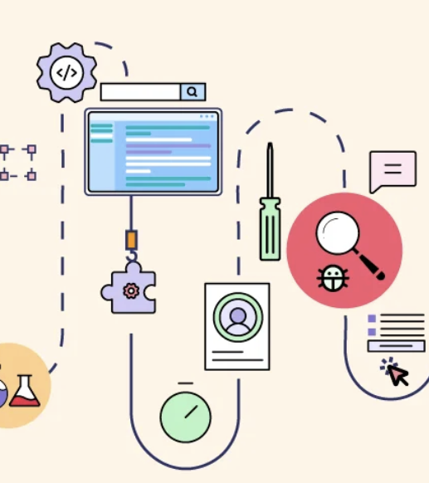
Design Patterns
Singleton
Enums in Java and Spring boot beans are by default Singletons!
`DTOFactory`, `JwtTokenProvider`, `PasswordEncoder` as singletons
Builder
Most if not all Data Type Objects (DTOs) follow the Builder pattern
Factory
We have factory classes for ‘BusinessPersonFactory’ and Data Type Objects
Strategy
Taxation, payroll, and bonuses all follow the strategy pattern to promote runtime polymorphism
MVC Architecture (not a design pattern, but still used)
Spring-boot inherently follows MVC arch. and our program is designed as such
Controllers ➔ Service ➔ Repository
Models are the low-level data contained within a Repository and thus are not exactly part of the data flow
Streams (also not a design pattern, but still used)
Anywhere possible when handling data, streams are used to condense the parsing logic
This is especially true in Controllers

Slide 7
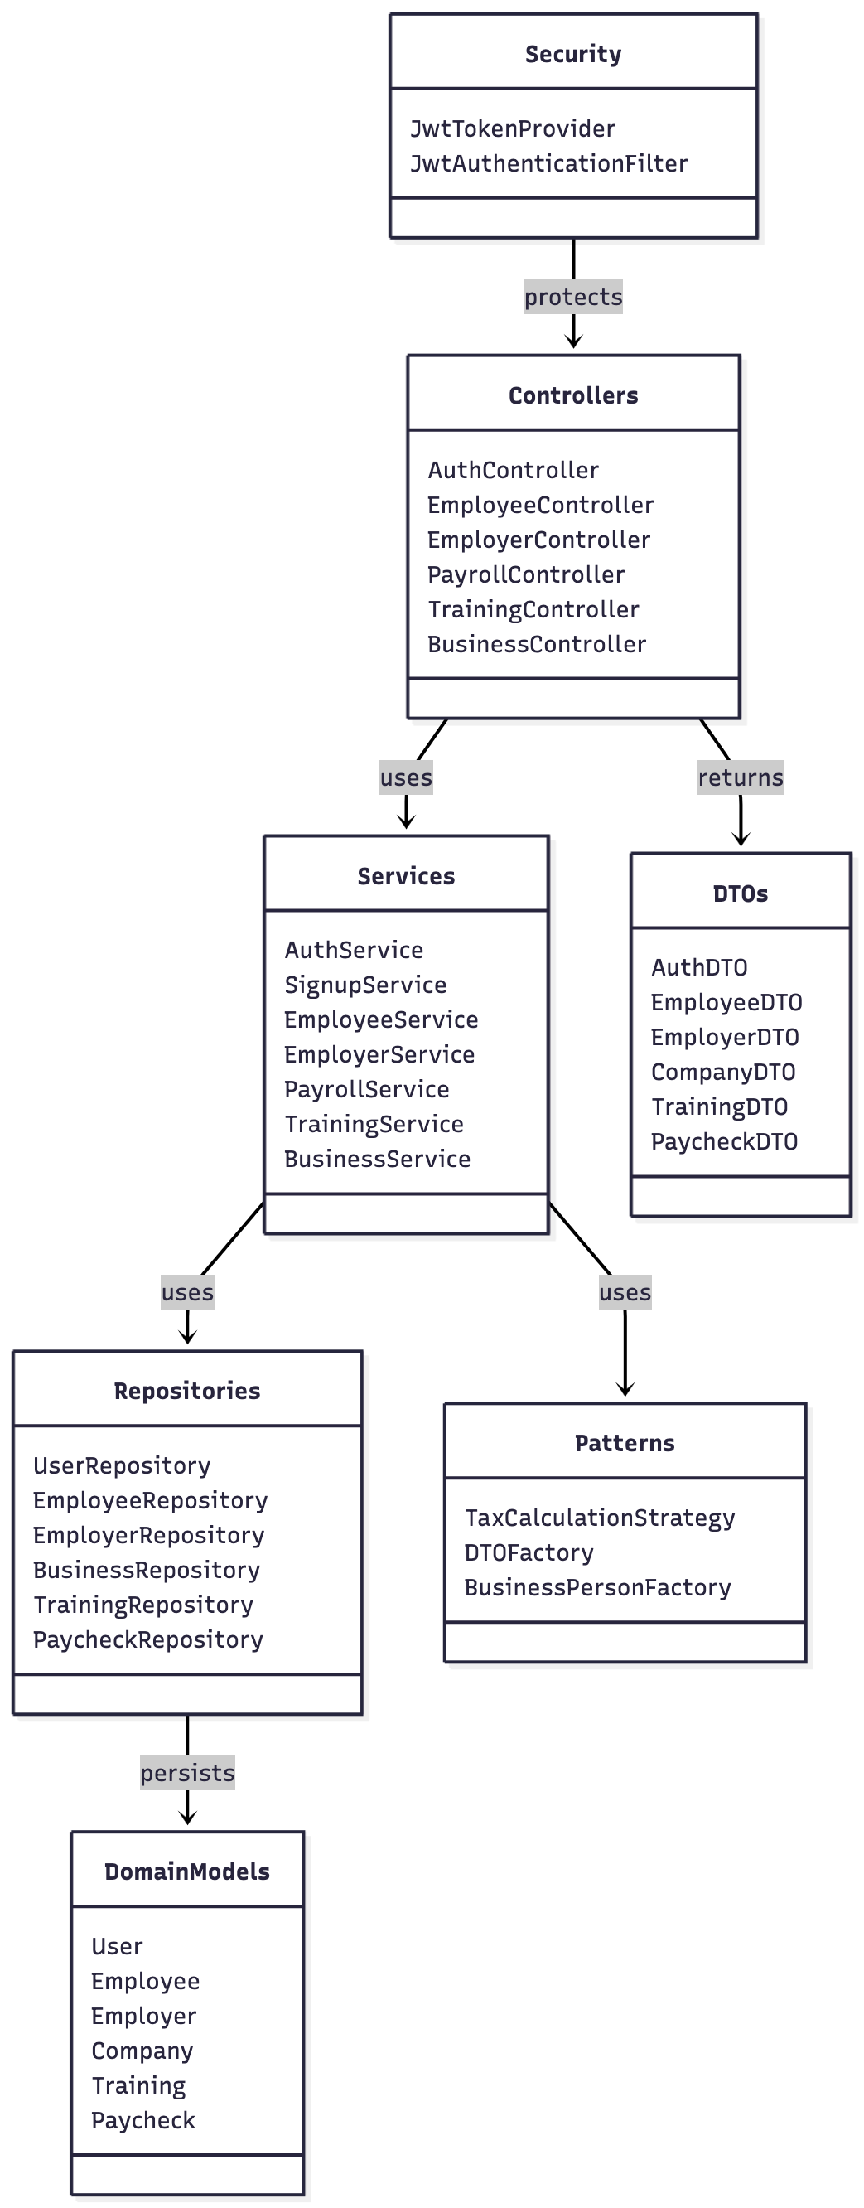

System Architecture

Slide 8

Future Scope
Hiring Logic ➔ Buzy has perfect integration capabilities for a candidate manager
Hiring can always be a complex, time-consuming, and expensive process for companies who usually cannot afford the cost nor the money away from the business
We can: Connect to the LinkedIn API, provide AI generated summaries of the candidate’s portfolio, likeness to the job, and so forth
Company Socials ➔ Since Buzy collects so much data on small business, it is a great platform for small businesses to connect with one another
Collaborations among small-businesses are rare, but do boost the profits of both companies alike
Finding companies who share the same values as your own is a difficult and again time- consuming process
Buzy can make this easier with a matching-like extension of the application

Slide 9
Summarized milestones
Milestone 1:
Foundation & Architecture
Spring Boot MVC architecture + MySQL database integration
Core domain models + Design patterns implementation
CSV-based database seeding with functional interfaces
Milestone 2:
Business Logic & API Development
Complete REST API controllers and services for all entities
Implemented DTO pattern for request/response separation and validation
Established global exception handling and custom exception classes
Milestone 3:
Frontend Integration & Core Features
Integrated JWT authentication and backend endpoints with React frontend
Built responsive layouts with role-based navigation (Employer/Employee views)
Established reusable component library (Card, Badge, Button) and custom hooks
Milestone 4:
Advanced Features & Polish
Enhanced dashboards with real-time statistics and interactive visualizations
Developed interactive company hierarchy tree with search and department grouping
Robust testing for Service classes

Slide 10
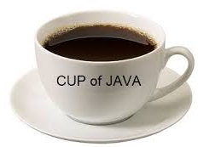

Key Takeaways
Jacob ➔ learning similar information presented in a new manner allows us to learn and realize things we never did before
Qing ➔ understanding how object-oriented design works like building blocks. You start with simple, well-defined models and entities, then combine them together using architectural patterns to create something complex and scalable. It's not just about writing code that works, but about thinking systematically how different pieces fit together.
Lotus ➔ these learning help me see progrmming in a new way. I learned how classes work like building blocks. Simple parts can grow into larger systems when we use patterns. I now understand that OOD is not only about writing code, but also about clear structure, good design, and long-term thinking.

